Slide 1

School of Computing and Computer Engineering
CSC 691: Topics in CS – Fall 2021
Project: Image Manipulation Detection using Convolutional Neural Network
UNDER THE GUIDANCE OF
Dr. Kala R. Marapareddy By
Krishnakanth Yachareni (W10098930)

Slide 2
Abstract
The development of smart devices such as smartphones has a remarkable role in uploading and downloading images to social networks like Facebook, Instagram, and SNS (Social Network Service).
In the meantime, there has been a technique for manipulating an image using various methods with a specific purpose.
Image tampering can be done by counterfeit criminals for the purpose of counterfeiting.
Digital forensic techniques are needed to detect the tampering and manipulation of images for these illegal purposes and much research has been studied on these forensic techniques.
This project proposes an image manipulation detection algorithm using deep learning technology. The model based on a convolutional neural network (CNN) is designed.
Especially, a high pass filter is used to acquire hidden features in the image rather than semantic information in the image.
The convolutional layer is composed of 2 layers having maximum pooling, ReLU (Rectified Linear Unit) activation, and local response normalization. The fully connected layer is composed of 2 layers.

Slide 3
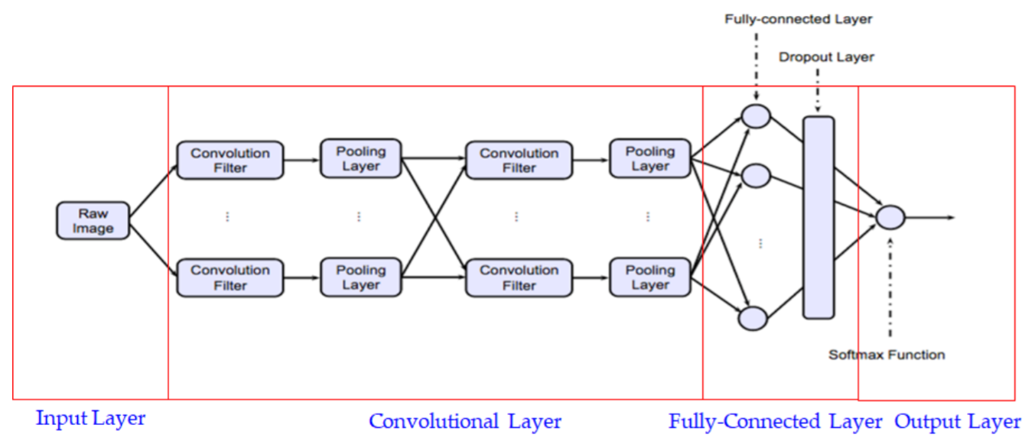
Deep Learning
The CNN is a deep learning algorithm, which is specialized in image processing
Input Layer:
It is a passage through which pixels of an image for learning are entered.
Its size is related to the number of image pixels
Convolutional Layer:
It consists of various convolution filters
Across the convolutional layer, the result values are passed to the next layer in a nonlinearity.
In the pooling layer, the dimensionality of the data is reduced

Slide 4
Contd….!
Fully connected Layer:
The classification is performed according to the learned results and multiple fully connected layers can be stacked
Its size is related to the number of image pixels
Drop-out can be applied between each layer to prevent over-fitting or underfitting
Output Layer:
It is learned to score each class and in general SoftMax function is used
The computation of convolution in a neural network is a product of a two-dimensional matrix called an image and a kernel or mask

Slide 5
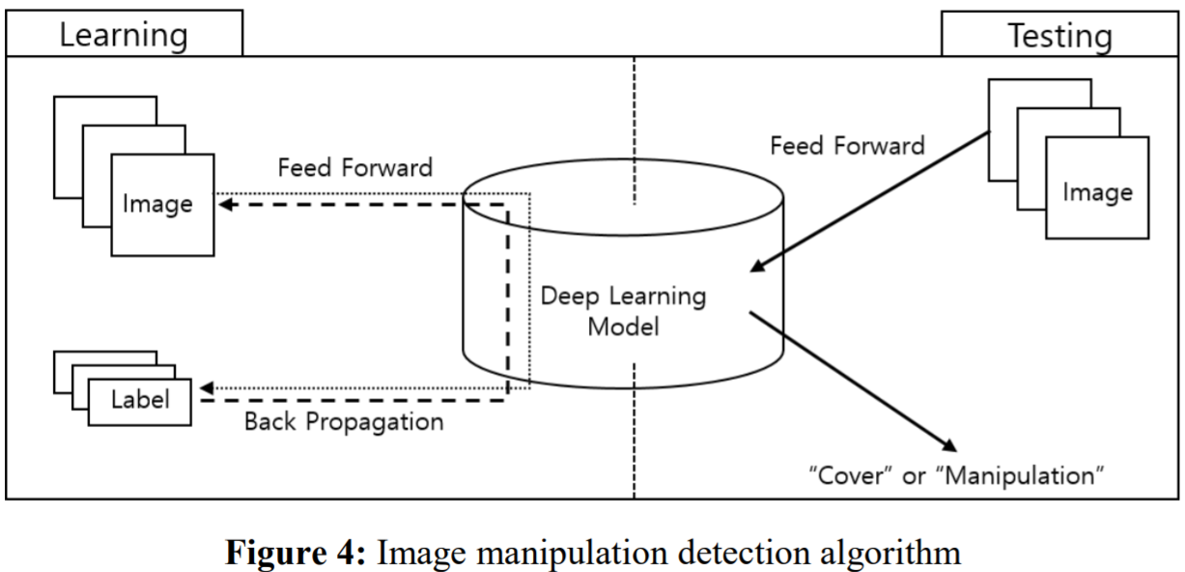
Project Implementation
First, I manipulate the original image to produce a manipulated image.
The generated image is classified into a learning set and a test set.
Then, the learning set is fed into the proposed CNN model.
After learning, the test set is fed into the model that has been learned, and the accuracy is calculated by analyzing the result

Slide 6
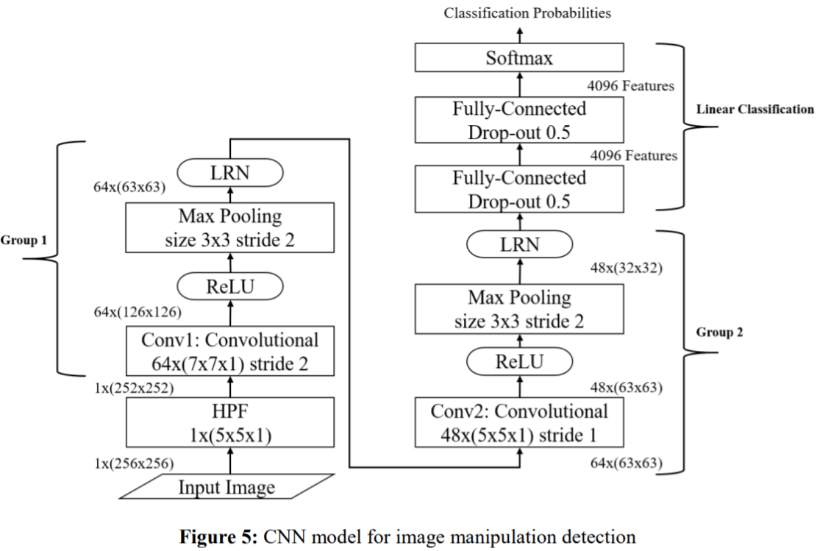
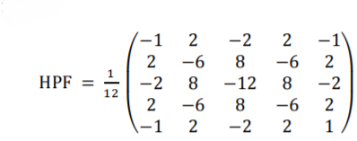
Proposed CNN Model
The model is composed of 1 high pass filter, 2 convolutional layers, 2 fully connected layers, and 1 output layer.
In general, for image classification research, there is use of image pixel data. It behaves as if it was personally classified those that cannot be distinguished by human eyes.
So, we apply HPF called by High Pass Filter to extract hidden features within the image as follows:

Slide 7
Proposed CNN Model
Conv1 uses Xavier initialization, which is the square of the input value and the input value of the random number value of the output value
The Conv2 layer allows 126x126 neuron values to pass through a 5x5 kernel
At every convolution layer, I use an activation function called ReLU (Rectifier Linear Units). ReLU changes the output to the value of f(x) = max (0, x).
CNN network generally have a very large number of neurons, this increases the complexity of learning problem, To solve this problem pooling layer, such as maximum pooling or average pooling is used.
Each fully connected layer has 4096 neurons, with a standard deviation of 0.4.
A drop-out layer of 0.5 to each layer to solve the over-fitting problem.
Used the softmax layer as the last layer for discrimination.

Slide 8
Environment Setup
Google Tensorflow as a deep learning framework
The GPU of NVidia GeForce 1080Ti is used (Tried to use free version google colab)
The image batch size is set to 100
The images are 10,000 images of 512x512 size of Boss Base 1.01
First, 40,000 images of 256x256 size are created by dividing the images into two horizontally and vertically divided images.
The total of 200,000 images including the original images and images from 4 algorithms:
Median filtering
Gaussian blurring
AWGN (additive white Gaussian noise addition)
Re-Sampling
Of these, 80% (160,000 images) are used as learning data and 20% (40,000 images) are used as test images.

Slide 9
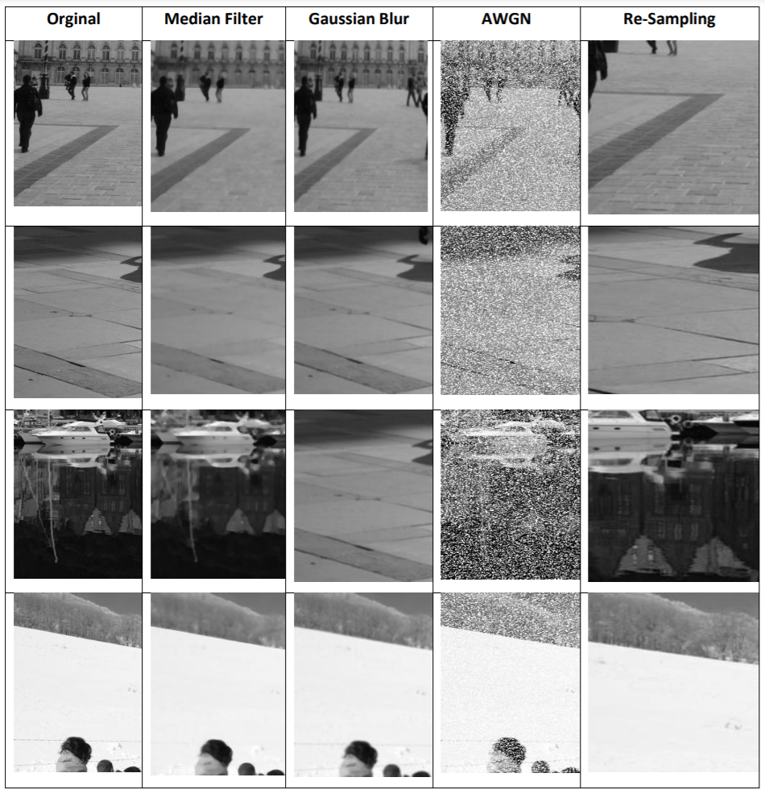
Samples of Test Images

Slide 10
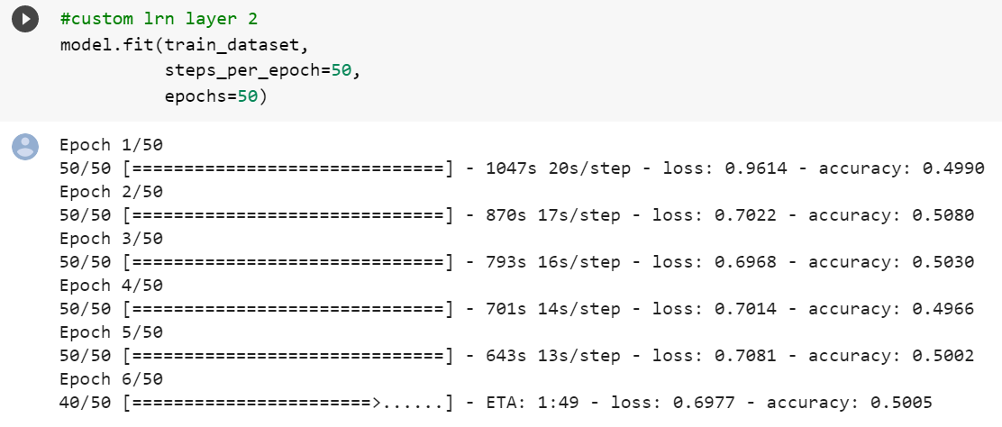
CNN Model Tuning

Slide 11
References
https://www.tensorflow.org/
https://keras.io/
http://www.ripublication.com/ijaer17/ijaerv12n21_156.pdf

